Slide 1
Multiple Access Networks (IEEE 802.3)

Slide 2
Multiple Access Networks (IEEE 802.3) – Ethernet
Token Ring(IEEE 802.5)
Wireless Networks (IEEE 802.11, 802.15)
IEEE 802.11 - Wireless Ethernet or Wireless LAN
IEEE 802.15- Bluetooth

Slide 3
Ethernet Evolution (IEEE 802.3)
The Ethernet LAN was developed in the 1970s by Robert Metcalfe and David Boggs.
Since then, it has gone through four generations:
Standard Ethernet (10 Mbps),
Fast Ethernet (100 Mbps),
Gigabit Ethernet (1 Gbps), and
10 Gigabit Ethernet (10 Gbps), as shown in Figure 1.

Slide 4
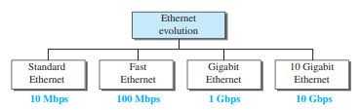
Ethernet evolution through four generation
Figure 1 Ethernet evolution through four generations

Slide 5
STANDARD ETHERNET: Characteristics
The original Ethernet technology with the data rate of 10 Mbps as the Standard Ethernet.
Characteristics
some characteristics of the Standard Ethernet.
Connectionless and Unreliable Service
Frame Format
Frame Length

Slide 6
STANDARD ETHERNET : Characteristics
Connectionless and Unreliable Service
Ethernet provides a connectionless service, which means each frame sent is independent of the previous or next frame.
Ethernet has no connection establishment or connection termination phases.
The sender sends a frame whenever it has it; the receiver may or may not be ready for it.
The sender may overwhelm the receiver with frames, which may result in dropping frames.
If a frame drops, the sender will not know about it. Since IP, which is using the service of Ethernet, is also connectionless, it will not know about it either.

Slide 7
STANDARD ETHERNET : Characteristics
If the transport layer is also a connectionless protocol, such as UDP, the frame is lost and salvation may only come from the application layer.
However, if the transport layer is TCP, the sender TCP does not receive acknowledgment for its segment and sends it again.

Slide 8
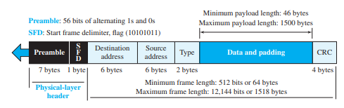
STANDARD ETHERNET : Characteristics
Frame Format
The Ethernet frame contains seven fields, as shown in Figure 2.
Figure 2 Ethernet frame

Slide 9
STANDARD ETHERNET : Characteristics
Preamble.
This field contains 7 bytes (56 bits) of alternating 0s and 1s that alert the receiving system to the coming frame and enable it to synchronize its clock if it’s out of synchronization.
The preamble is actually added at the physical layer and is not (formally) part of the frame

Slide 10
STANDARD ETHERNET : Characteristics
Start frame delimiter (SFD).
This field (1 byte: 10101011) signals the beginning of the frame.
The last 2 bits are (11)2 and alert the receiver that the next field is the destination address.
The SFD field is also added at the physical layer
Destination address (DA).
This field is six bytes (48 bits) and contains the linklayer address of the destination station or stations to receive the packet.

Slide 11
STANDARD ETHERNET : Characteristics
Source address (SA). This field is also six bytes and contains the link-layer address of the sender of the packet. We will discuss addressing shortly.
Type. This field defines the upper-layer protocol whose packet is encapsulated in the frame. This protocol can be IP, ARP, OSPF, and so on
Data. This field carries data encapsulated from the upper-layer protocols. It is a minimum of 46 and a maximum of 1500 bytes.
CRC. The last field contains error detection information, in this case a CRC-32. The CRC is calculated over the addresses, types, and data field.

Slide 12
Efficiency of Standard Ethernet
The efficiency of the Ethernet is defined as the ratio of the time used by a station to send data to the time the medium is occupied by this station. The practical efficiency of standard Ethernet has been measured to be
Efficiency =1 / (1 + 6.4 * a)
in which the parameter “a” is the number of frames that can fit on the medium. It can be calculated as a = (propagation delay)/(transmission delay) because the transmission delay is the time it takes a frame of average size to be sent out and the propagation delay is the time it takes to reach the end of the medium.
In the ideal case, a = 0 and the efficiency is 1.

Slide 13

Implementation
The Standard Ethernet defined several implementations, but only four of them became popular during the 1980s. Table 1 shows a summary of Standard Ethernet implementations.
In the nomenclature 10BaseX, the number defines the data rate (10 Mbps), the term Base means baseband (digital) signal, and X approximately defines either the maximum size of the cable in 100 meters (for example 5 for 500 or 2 for 185 meters) or the type of cable
Table 1 Summary of Standard Ethernet implementations

Slide 14
FAST ETHERNET (100 Mbps)
In the 1990s, some LAN technologies with transmission rates higher than 10 Mbps, such as FDDI and Fiber Channel, appeared on the market.
If the Standard Ethernet wanted to survive, it had to compete with these technologies.
Ethernet made a big jump by increasing the transmission rate to 100 Mbps, and the new generation was called the Fast Ethernet.

Slide 15
FAST ETHERNET (100 Mbps)
The goals of Fast Ethernet can be summarized as follows:
1. Upgrade the data rate to 100 Mbps.
2. Make it compatible with Standard Ethernet.
3. Keep the same 48-bit address.
4. Keep the same frame format

Slide 16

Fast Ethernet implementations
Fast Ethernet implementation at the physical layer can be categorized as either two-wire or four-wire. The two-wire implementation can be either shielded twisted pair (STP), which is called 100Base-TX, or fiber-optic cable, which is called 100Base-FX. The four-wire implementation is designed only for unshielded twisted pair (UTP), which is called 100Base-T4.
Table 2 Summary of Fast Ethernet implementations

Slide 17
GIGABIT ETHERNET
The need for an even higher data rate resulted in the design of the Gigabit Ethernet Protocol (1000 Mbps).
The IEEE committee calls it the Standard 802.3z.
The goals of the Gigabit Ethernet were to upgrade the data rate to 1 Gbps, but keep the address length, the frame format, and the maximum and minimum frame length the same.

Slide 18
GIGABIT ETHERNET
The goals of the Gigabit Ethernet design can be summarized as follows
1. Upgrade the data rate to 1 Gbps.
2. Make it compatible with Standard or Fast Ethernet.
3. Use the same 48-bit address.
4. Use the same frame format.
5. Keep the same minimum and maximum frame lengths.
6. Support autonegotiation as defined in Fast Ethernet.
Note: Auto-negotiation is the feature that allows a port on a switch, router, server, or other device to communicate with the device on the other end of the link to determine the optimal duplex mode and speed for the connection

Slide 19
MAC Sublayer
A main consideration in the evolution of Ethernet was to keep the MAC sublayer untouched. However, to achieve a data rate of 1 Gbps
Gigabit Ethernet has two distinctive approaches for medium access:
half-duplex and fullduplex.
Almost all implementations of Gigabit Ethernet follow the full-duplex approach, so we mostly ignore the half-duplex mode

Slide 20

Implementation Summary
Gigabit Ethernet can be categorized as either a two-wire or a four-wire implementation.
The two-wire implementations use fiber-optic cable (1000Base-SX, short-wave, or 1000Base-LX, long-wave), or STP (1000Base-CX) (short-haul copper). The four-wire version uses category 5 twisted-pair cable (1000Base-T).
In other words, we have four implementations. 1000Base-T was designed in response to those users who had already installed this wiring for other purposes such as Fast Ethernet or telephone services

Slide 21
10 GIGABIT ETHERNET
The IEEE committee created 10 Gigabit Ethernet and called it Standard 802.3ae.
The goals of the 10 Gigabit Ethernet design can be summarized as upgrading the data rate to 10 Gbps, keeping the same frame size and format, and allowing the interconnection of LANs, MANs, and WAN possible.
This data rate is possible only with fiber-optic technology at this time. The standard defines two types of physical layers: LAN PHY and WAN PHY

Slide 22

Implementation of 10 GIGABIT ETHERNET
10 Gigabit Ethernet operates only in full-duplex mode, which means there is no need for contention; CSMA/CD is not used in 10 Gigabit Ethernet.
Four implementations are the most common: 10GBase-SR, 10GBase-LR, 10GBase-EW, and 10GBase-X4.

Slide 23
Token Ring (IEEE 802.5)
Definition
The foundation of a token ring is the IEEE 802.5 network of the “Institute of Electrical and Electronics Engineers” from 1985, in which all participants of the “Local Area Network” (LAN) are connected to form a logical ring.
Usually token ring topologies have a transmission speed of 4 or 16 Mbit/s, but in theory speeds of 100 Mbit/s or 1 Gbit/s are also possible.
A token ring is an outdated form of network technology, and today Ethernet is the most prevalent type of wired LAN connection.

Slide 24
Token Ring (IEEE 802.5)
Token ring is the IEEE 802.5 standard for a token-passing ring in Communication networks.
A ring consists of a collection of ring interfaces connected by point-to-point lines i.e. ring interface of one station is connected to the ring interfaces of its left station as well as right station.
Internally, signals travel around the Communication network from one station to the next in a ring.
Token Ring is a LAN protocol defined in the IEEE 802.5 where all stations are connected in a ring and each station can directly hear transmissions only from its immediate neighbor.
Permission to transmit is granted by a message (token) that circulates around the ring.
A token is a special bit pattern (3 bytes long). There is only one token in the network.

Slide 25
Token Ring (IEEE 802.5)
The network access mechanism used by Ethernet (CSMA/CD) may result in collision.
Station may attempt to send data multiple times before a transmission makes it onto the link.
This redundancy may create delays if the traffic is heavy.
Token ring resolves this uncertainty by requiring that stations take turns sending data. Each station may transmit only during its turn and may send only one frame during each turn.
The mechanism that coordinates this rotation is called token passing.

Slide 26
Token Ring (IEEE 802.5) - Access Method: Token Passing
Token Passing is shown in Fig. 1.
Whenever the network is unoccupied, it circulates a simple three byte token. The station waits for the token to enter its network. If token is free, the station may then send a data frame.
The data frame proceeds around the ring, being regenerated by each station. Each intermediate station examines the destination

Slide 27
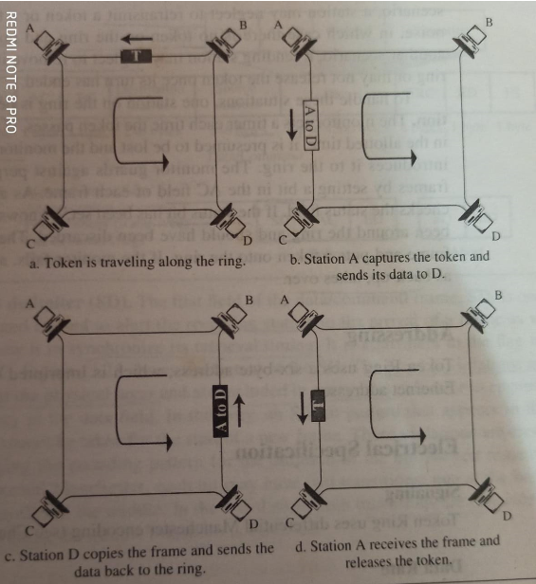
Fig. 1 Token Passing

Slide 28
Token Ring (IEEE 802.5) - Access Method: Token Passing
Priority and Reservation
Once a token has been released, the next station on the ring with data to send has the right to take charge of the ring.
The busy token can be reserved by a station waiting to transmit.
Each station has a priority code. A station with a higher priority may remove a lower priority reservation and replace it with its own.
Time Limits
To keep traffic moving, Token ring imposes a time limit on any station waiting to use the ring

Slide 29
Wireless LAN IEEE 802.11

Slide 30
Wireless LAN IEEE 802.11
IEEE has defined the specifications for a wireless LAN, called IEEE 802.11, which covers the physical and data-link layers.
It is sometimes called wireless Ethernet.
In some countries, including the United States, the public uses the term WiFi (short for wireless fidelity) as a synonym for wireless LAN.

Slide 31
Architecture Wireless LAN IEEE 802.11
The standard defines two kinds of services: the basic service set (BSS) and the extended service set (ESS).
Basic Service Set
IEEE 802.11 defines the basic service set (BSS) as the building blocks of a wireless LAN.
A basic service set is made of stationary or mobile wireless stations and an optional central base station, known as the access point (AP).
Figure 1 shows two sets in this standard.

Slide 32
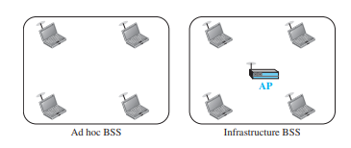
Basic service sets (BSSs)
The BSS without an AP is a stand-alone network and cannot send data to other BSSs. It is called an ad hoc architecture.
In this architecture, stations can form a network without the need of an AP; they can locate one another and agree to be part of a BSS.
A BSS with an AP is sometimes referred to as an infrastructure BSS.

Slide 33
Extended Service Set
An extended service set (ESS) is made up of two or more BSSs with Access Points (APs).
In this case, the BSSs are connected through a distribution system, which is a wired or a wireless network.
The distribution system connects the APs in the BSSs.
IEEE 802.11 does not restrict the distribution system; it can be any IEEE LAN such as an Ethernet.
Note that the extended service set uses two types of stations: mobile and stationary.
The mobile stations are normal stations inside a BSS.
The stationary stations are AP stations that are part of a wired LAN. Figure 2 shows an ESS.

Slide 34
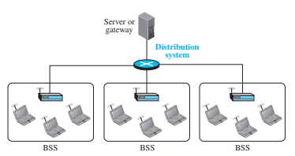
Extended Service Set
Figure 2 Extended service set (ESS)
When BSSs are connected, the stations within reach of one another can communicate without the use of an AP. However, communication between a station in a BSS and the outside BSS occurs via the AP.
The idea is similar to communication in a cellular network, if we consider each BSS to be a cell and each AP to be a base station. Note that a mobile station can belong to more than one BSS at the same time.

Slide 35
Station Types
IEEE 802.11 defines three types of stations based on their mobility in a wireless LAN: no-transition, BSS-transition, and ESS-transition mobility.
A station with no-transition mobility is either stationary (not moving) or moving only inside a BSS.
A station with BSS-transition mobility can move from one BSS to another, but the movement is confined inside one ESS.
A station with ESS-transition mobility can move from one ESS to another.
However, IEEE 802.11 does not guarantee that communication is continuous during the move.

Slide 36
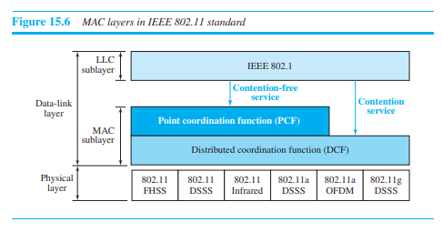
MAC Sublayer
IEEE 802.11 defines two MAC sublayers: the distributed coordination function (DCF) and point coordination function (PCF).
Figure 3 shows the relationship between the two MAC sublayers,
the LLC sublayer, and the physical layer.
Figure 3 MAC layers in IEEE 802.11 standard

Slide 37
Distributed Coordination Function
One of the two protocols defined by IEEE at the MAC sublayer is called the distributed coordination function (DCF). DCF uses CSMA/CA as the access method
Frame Exchange Time Line
Figure 4 shows the exchange of data and control frames in time.
Before sending a frame, the source station senses the medium by checking the energy level at the carrier frequency.
a. The channel uses a persistence strategy with backoff until the channel is idle.
b. After the station is found to be idle, the station waits for a period of time called the distributed interframe space (DIFS); then the station sends a control frame called the request to send (RTS).
After receiving the RTS and waiting a period of time called the short interframe space (SIFS), the destination station sends a control frame, called the clear to send (CTS), to the source station. This control frame indicates that the destination station is ready to receive data.
The source station sends data after waiting an amount of time equal to SIFS.
The destination station, after waiting an amount of time equal to SIFS, sends an acknowledgment to show that the frame has been received.

Slide 38
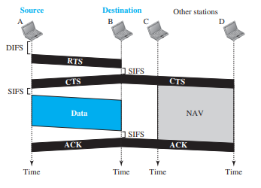
Figure 4 CSMA/CA and NAV

Slide 39
Network Allocation Vector
When a station sends an RTS frame, it includes the duration of time that it needs to occupy the channel.
The stations that are affected by this transmission create a timer called a network allocation vector (NAV) that shows how much time must pass before these stations are allowed to check the channel for idleness.
Each time a station accesses the system and sends an RTS frame, other stations start their NAV.
In other words, each station, before sensing the physical medium to see if it is idle, first checks its NAV to see if it has expired. Figure 4 shows the idea of NAV.

Slide 40
Collision During Handshaking
What happens if there is a collision during the time when RTS or CTS control frames are in transition, often called the handshaking period?
Two or more stations may try to send RTS frames at the same time.
These control frames may collide.
However, because there is no mechanism for collision detection, the sender assumes there has been a collision if it has not received a CTS frame from the receiver.
The backoff strategy is employed, and the sender tries again.

Slide 41
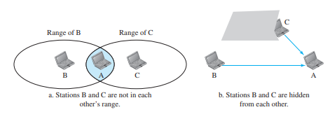
Hidden-Station Problem
The solution to the hidden station problem is the use of the handshake frames (RTS and CTS).
Figure 4 also shows that the RTS message from B reaches A, but not C.
However, because both B and C are within the range of A, the CTS message, which contains the duration of data transmission from B to A, reaches C.
Station C knows that some hidden station is using the channel and refrains from transmitting until that duration is over.

Slide 42
IEEE 802.15 - Bluetooth

Slide 43
IEEE 802.15 - Bluetooth
Bluetooth is a wireless LAN technology designed to connect devices of different functions such as telephones, notebooks, computers (desktop and laptop), cameras, printers, and even coffee makers when they are at a short distance from each other.
A Bluetooth LAN is an ad hoc network, which means that the network is formed spontaneously; the devices, sometimes called gadgets, find each other and make a network called a piconet.
A Bluetooth LAN can even be connected to the Internet if one of the gadgets has this capability.

Slide 44
IEEE 802.15 - Bluetooth
Bluetooth was originally started as a project by the Ericsson Company.
It is named for Harald Blaatand, the king of Denmark (940-981) who united Denmark and Norway.
Blaatand translates to Bluetooth in English.
Today, Bluetooth technology is the implementation of a protocol defined by the IEEE 802.15 standard.
The standard defines a wireless personal-area network (PAN) operable in an area the size of a room or a hall

Slide 45
Bluetooth Architecture : Piconets
Bluetooth defines two types of networks: piconet and scatternet.
Piconets
A Bluetooth network is called a piconet, or a small net.
A piconet can have up to eight stations, one of which is called the primary; the rest are called secondaries.
All the secondary stations synchronize their clocks and hopping sequence with the primary.
Note that a piconet can have only one primary station. The communication between the primary and secondary stations can be one-to-one or one-to-many. Figure 5 shows a piconet.

Slide 46
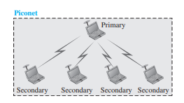
Bluetooth Architecture: Piconets
Although a piconet can have a maximum of seven secondaries, additional secondaries can be in the parked state.
A secondary in a parked state is synchronized with the primary, but cannot take part in communication until it is moved from the parked state to the active state.
Because only eight stations can be active in a piconet, activating a station from the parked state means that an active station must go to the parked state.
Figure 5 Piconet

Slide 47
Bluetooth Architecture : Scatternet
Scatternet
Piconets can be combined to form what is called a scatternet.
A secondary station in one piconet can be the primary in another piconet.
This station can receive messages from the primary in the first piconet (as a secondary) and, acting as a primary, deliver them to secondaries in the second piconet.
A station can be a member of two piconets. Figure 6 illustrates a scatternet.

Slide 48
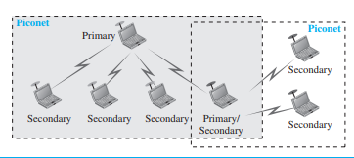
Bluetooth Architecture : Scatternet
Figure 6 Scatternet

Slide 49
Bluetooth Devices
A Bluetooth device has a built-in short-range radio transmitter.
The current data rate is 1 Mbps with a 2.4-GHz bandwidth.
This means that there is a possibility of interference between the IEEE 802.11b wireless LANs and Bluetooth LANs.

